Slide 1
2010 Uniform Crime Report Data
Noblesville Police Department
Noblesville, Indiana

Slide 2
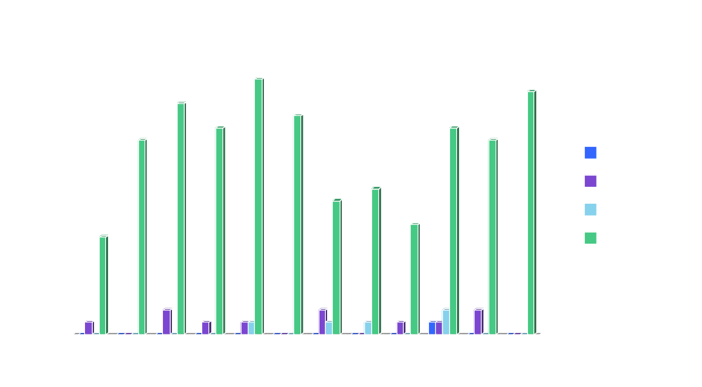
Crimes Against Persons

Slide 3
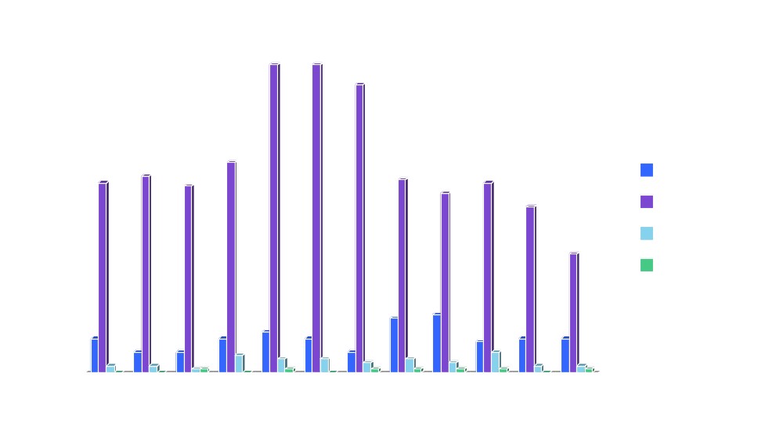
Property Crimes

Slide 4
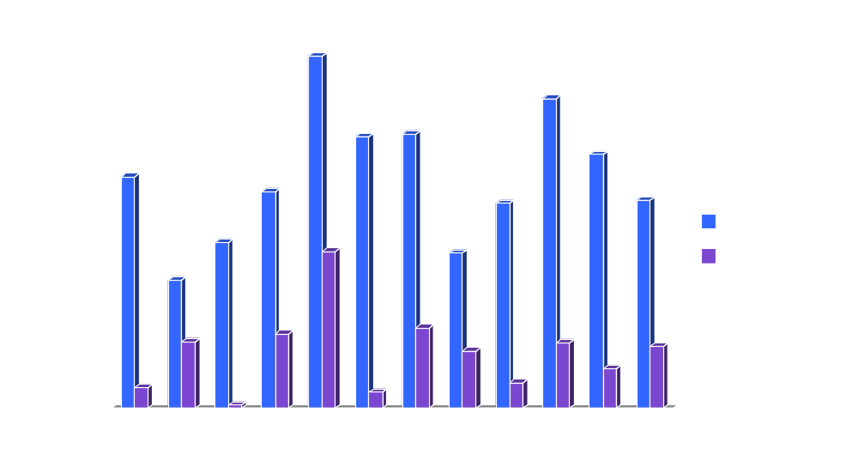
Property Stolen and Recovered

Slide 5

Crimes Against Persons by Year

Slide 6
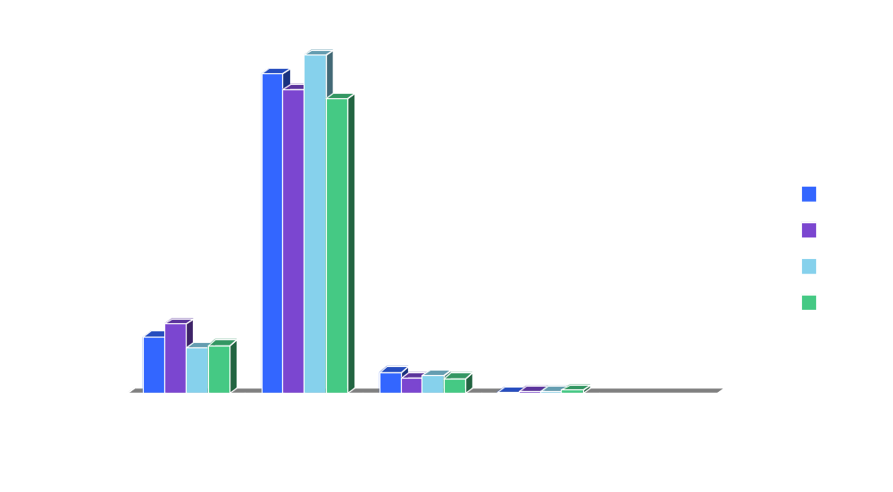
Property Crimes by Year

Slide 7

Part 1 Crimes by Year

Slide 8
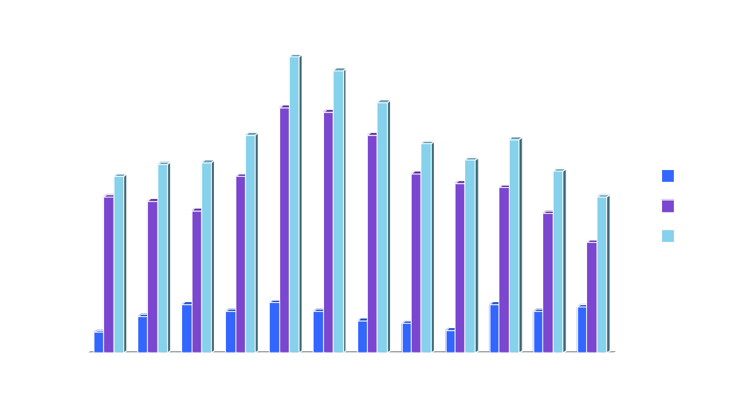
Total Part 1 Offenses

